Slide 1


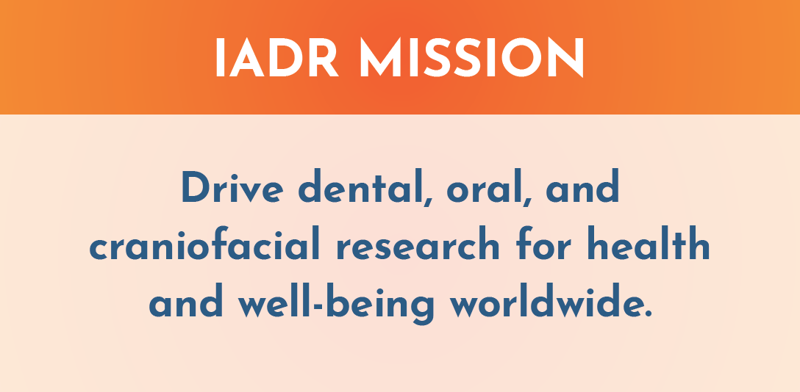
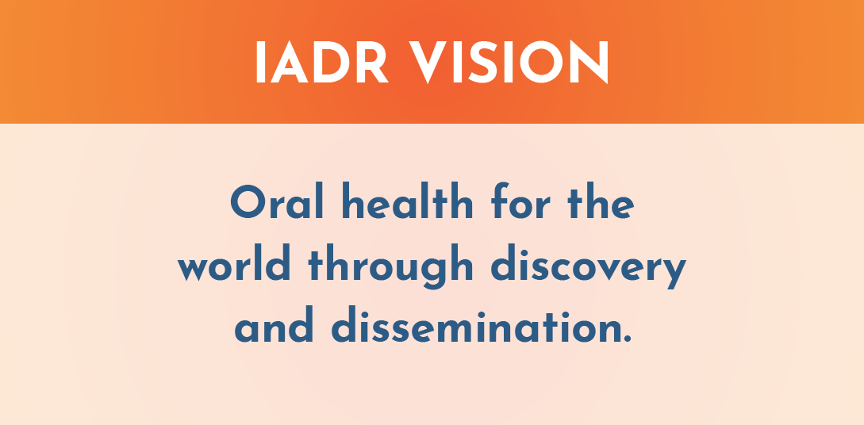
The IADR is a nonprofit organization with a mission to drive dental, oral, and craniofacial research for health and well-being worldwide. IADR represents the individual scientists, clinician-scientists, dental professionals, and students based in academic, government, non-profit and private-sector institutions who share our mission.

Slide 2
IADR Values
Scientific Excellence
IADR values science conducted at the highest possible levels of rigor, innovation and ethics, across disciplines, from discovery science to clinical implementation to global population health.
Social Responsibility
IADR values the pursuit of science to improve health and well-being for all people, to reduce health inequalities and inequities, and proactively takes actions and positions to improve health.
Scientific Community
IADR values a diverse and inclusive scientific workforce, promotes work-life balance, and supports educational activities and mentoring networks to develop the next generation of scientists.
Notes:
The IADR Core Values are: Excellence, Responsibility and Community.

Slide 3
Board of Directors
  President
  Satoshi Imazato, Osaka University, Japan
  President-elect
  Pamela Yelick, Tufts University, Boston, MA, USA
  Vice-president
  Jennifer Gallagher, King’s College London, England, UK
  Immediate Past President
  Ophir Klein, Cedars-Sinai, Los Angeles, CA, USA
  Treasurer
  Alvaro Della Bona, University of Passo Fundo, Brazil
  Regional Board Member, Africa/Middle East Region
  Sadika Khan, University of Western Cape, Cape Town, South Africa
  Regional Board Member - Asia/Pacific Region
  Yong-Ouk You, Wonkwang University, Iksan, Republic of Korea
  Regional Board Member - Pan European Region
  Marcello Riggio, University of Glasgow, Scotland
  Regional Board Member - Latin American Region
  Gabriel Sanchez, Universidad de Buenos Aires, Argentina
  Regional Board Member - North American Region
  Olga Baker, University of Missouri-Columbia, USA
  Young Investigator Representative
  Gustavo Nascimento, National Dental Research Institute Singapore
  Young Investigator Representative
  Fatemeh Momen-Heravi, Columbia University, New York, USA
  JDR Editor-in-Chief
  Nicholas Jakubovics, Newcastle University, England, UK
  JDR CTR Editor-in-Chief
  Jocelyne Feine, McGill University, Montreal, Canada
  Chief Executive Officer
  Christopher H. Fox, IADR, Alexandria,
  VA, USA

Slide 4


IADR Regional Structure
IADR
NAR
LAR
APR
PER
AMER
East & Southern African
Iranian
Iraqi
Kuwaiti
Nigerian
Saudi Arabian
South African
Egyptian
Jordanian
Lebanese
Libyan
Palestinian
Qatari
Sudanese
Syrian
Tunisian
United Arab Emirates
ANZ
Chinese
Indian
Japanese
Korean
SEA
Mongolian
Pakistani
Argentine
Brazilian
Chilean
Colombian
Costa Rican
Peruvian
Uruguayan
Venezuelan
Bolivian
Caribbean
Ecuadorian
Guatemalan
Panamanian
Paraguayan
AADOCR
CADR
Mexican
British
CED
Irish
Israeli
Scandinavian
Russian
29 Divisions: Black
19 Sections: Blue

Slide 5
2024 IADR Membership by Region
PER
NAR
1,723
3,575
APR
2,326
AMER
LAR
664
808
Total Membership: 9,096

Slide 6

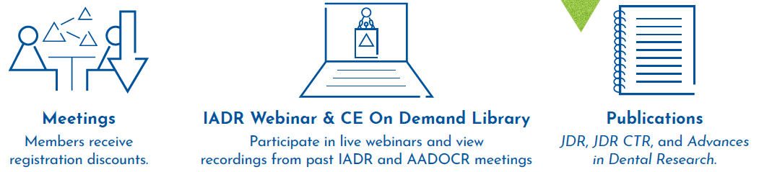
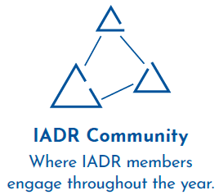


Membership Benefits
Notes:
An IADR membership offers many benefits including access to the online IADR Community, IADR Webinar & CE On Demand Library, publications, discounts on meeting registrations, presentation and awards/fellowship opportunities, access to the abstract archive, the Global Research Update newsletter, membership in IADR Scientific Groups or Networks and much more.

Slide 7
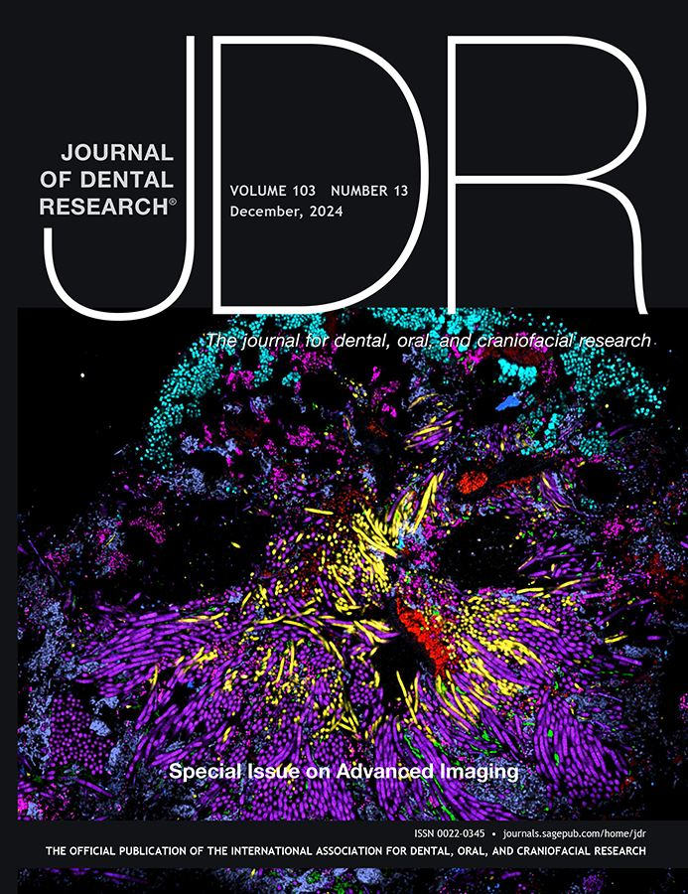
Journal of Dental Research
Editor-in-Chief: Nicholas Jakubovics
Journal Citation Reports™ results for the JDR:
  2-year Journal Impact Factor™: 5.7, ranking #4 of 157
  5-year Journal Impact Factor™: 7.6, ranking #4 of 157
  Eigenfactor: 0.01265, ranking #3 of 157
  Immediacy Index: 1.1, ranking #13 of 157
  Total citations: 24,424, ranking #1 of 157
  Article Influence Score: 1.771, ranking #4 of 157
  Acceptance ratio (2022): 15%
  Acceptance ratio (2023): 13%
Published manuscripts appear in print and Online First, by which forthcoming articles are published online before they are scheduled to appear in print.
www.iadr.org/jdr
Follow the JDR on Twitter @JDentRes (75 Following, 2,663 Followers)

Slide 8
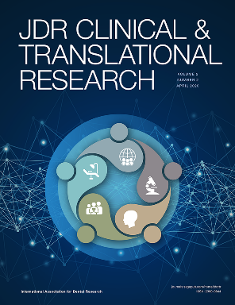
JDR Clinical & Translational Research
Editor-in-Chief: Jocelyne S. Feine
Journal Citation Reports™ results for the JDR CTR:
  Journal Impact Factor™: 2.2, ranking #52 of 157 journals
  Eigenfactor™: 0.00142
  Immediacy Index: 0.300
  Acceptance ratio (2022): 41.5%
  Acceptance ratio (2023): 25.2%
  Average Turnaround Times (2023):
    Submission to first decision: 35 days
    Submission to acceptance: 138 days
    Acceptance to online publications: 40 days
    Acceptance to print publication: 383 days
www.iadr.org/jdrctr
Follow the JDR CTR on Twitter @JDRClinTransRes (31 Following, 443 Followers)

Slide 9
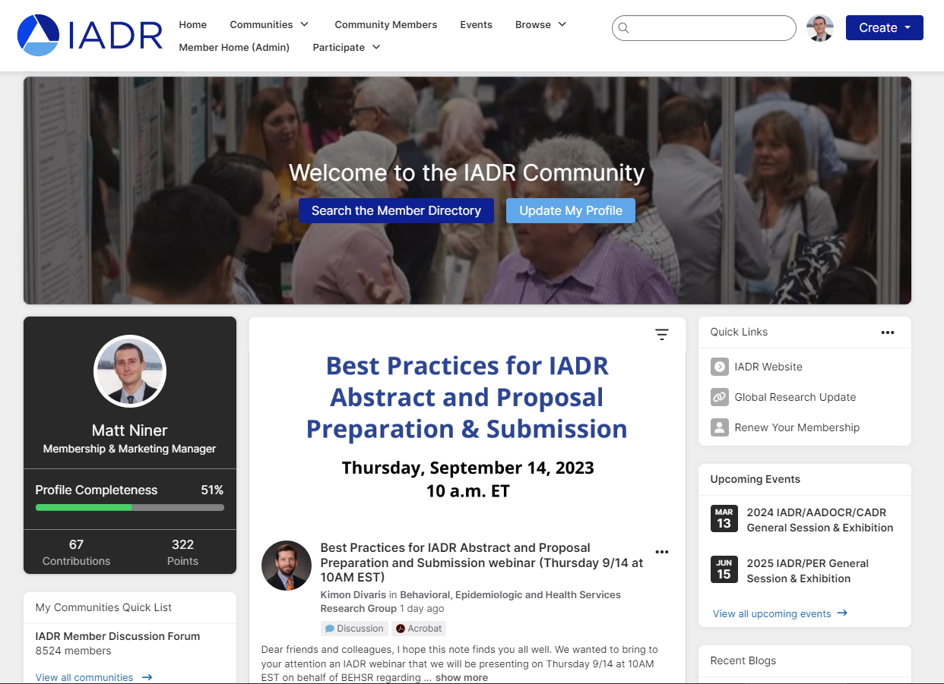
IADR Community
The IADR Community has been upgraded!
With a new design, a more intuitive interface, and improved search functionality, it’s now easier than ever for IADR members to engage throughout the year.

Slide 10
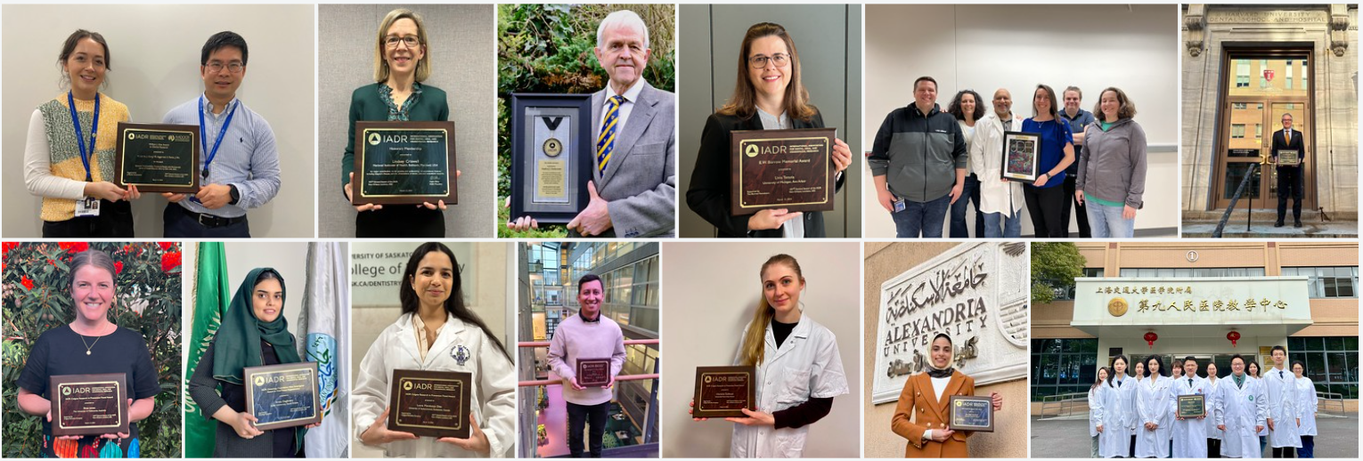
IADR Awards & Fellowships
40+ awards and fellowships in numerous categories
Distinguished Scientist Awards: 17 categories
Student & Scientific Group Awards
IADR Hatton Competition: Junior, Senior Clinical, & Senior Basic Science
Notes:
IADR has opportunities for members to be recognized for their research contributions through Awards and Fellowships. There are more than 40 awards and fellowships in various categories, including student awards. Visit the IADR website for the deadlines for the 2023 Awards and Fellowships.

Slide 11
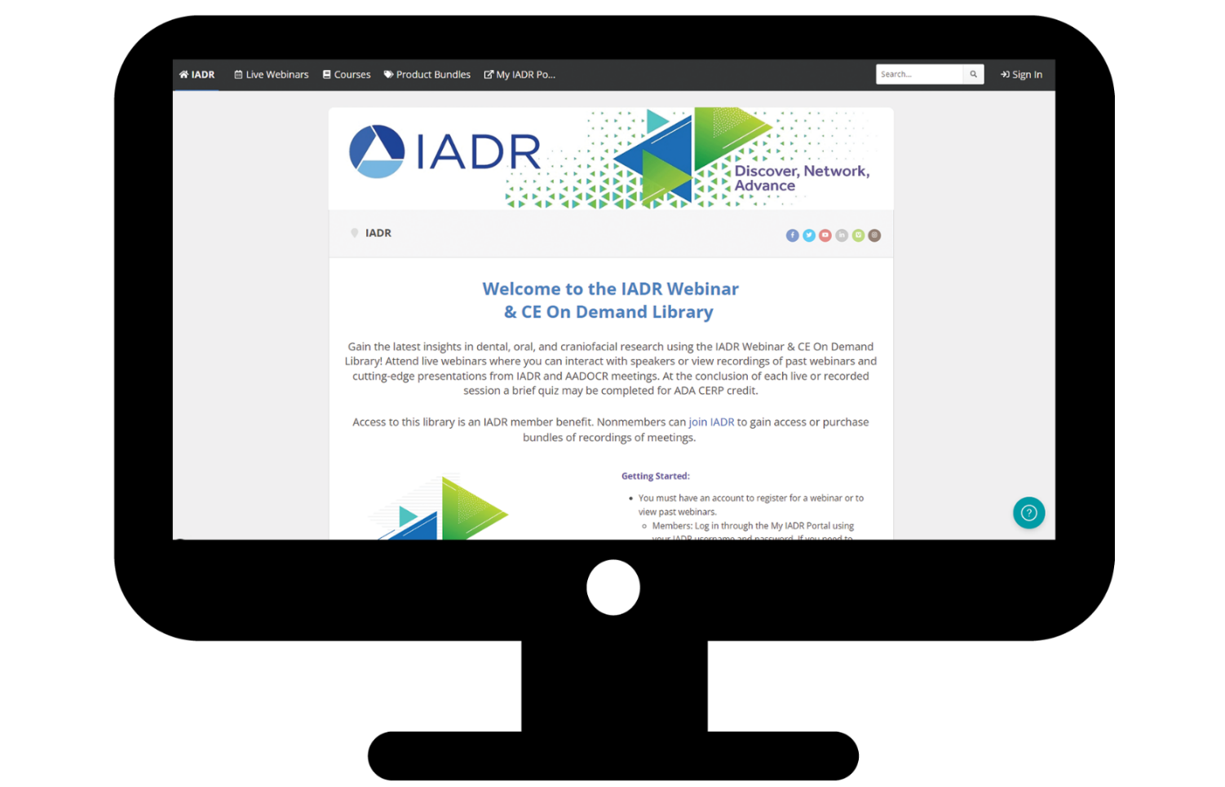
IADR Webinar & CE On Demand Library
Gain the latest insights in dental, oral, and craniofacial research using the IADR Webinar & CE On Demand Library! Attend live webinars, interact with speakers, and view recordings of past webinars and cutting-edge presentations from IADR and AADOCR meetings.
Notes:
Attend live webinars where you can interact with speakers or view recordings of past webinars and cutting-edge presentations from IADR and AADOCR meetings. Members can submit a webinar proposal for consideration!

Slide 12
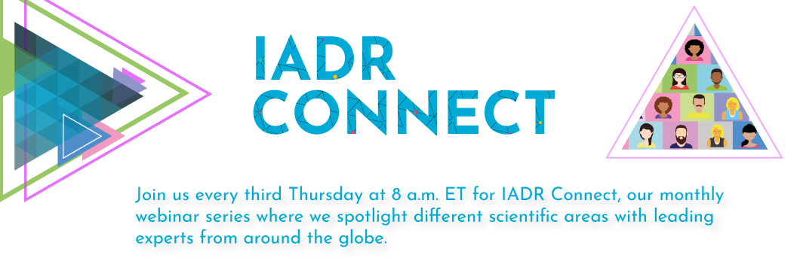
A New Members-Only Series by the IADR Scientific Groups & Networks

Slide 13
IADR Scientific Groups & Networks
Scientific Groups (25)
Behavioral, Epi & HSR
Cariology Research
Craniofacial Biology
Dental Anesthesiology and
Special Care Research
Dental Materials
Diagnostic Sciences
Education Research
Geriatric Oral Research
Implantology Research
Lasers & Biophotonics
Microbiology/Immunology
Mineralized Tissue
Networks (11)
Clinical and Translational Science
Digital Dentistry Research Network
e-Oral Health Network
Evidence-based Dentistry
Global Oral Health Inequalities Research
International Network for Orofacial Pain and Related Disorders Methodology (INfORM)
Minimally Invasive Dentistry Network
Network for Practice-based Research
Oral Malodor Network – NEW!
Student Training and Research (STAR)
Women in Science Network
Neuroscience
Nutrition Research
Oral & Maxillofacial Surgery
Oral Health Research
Oral Medicine & Pathology
Orthodontics Research
Pediatric Oral Health Research
Periodontal Research
Pharmacology/Therapeutics/
Toxicology
Prosthodontics
Pulp Biology & Regeneration
Salivary Research
Stem Cell Biology

Slide 14
IADR Support for Low and Middle-Income Countries (LMICs)
IADR Regional Development Program
IADR promotes oral health research worldwide with a specific emphasis on assistance and education. Since 1996, the Regional Development Program has distributed more than $1.3 million in funding to enhance capacity and infrastructure in regions with less developed research programs.
Awards and Fellowships
The IADR Centennial Travel Award for New Investigators, the IADR Newell W. Johnson Travel Award, and the IADR Smile Train Cleft Research Award offer funding specifically to members of LMICs to promote research development and attendance at the IADR General Sessions.
IADR Adopt-a-Member Fund
Donations to the fund directly support IADR Members and Student Members in LMICs in paying IADR annual membership dues and/or IADR General Session registration fees.
Tiered Dues and Registration Fees
IADR offers significantly discounted rates for individuals from LMICs on membership as well as for registration at the annual IADR General Session & Exhibition.

Slide 15
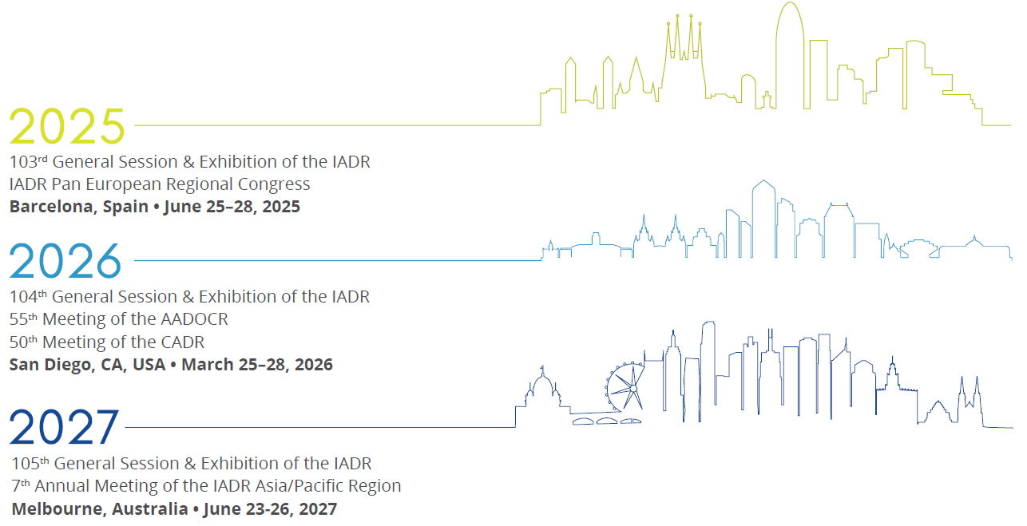
Future Meetings

Slide 16
Important Dates
January 24, 2025: Abstract Submission Close
February 28, 2025: Meeting Room Request Deadline
May 5, 2025: Presenter Pre-registration Deadline
#IADR2025

Slide 17

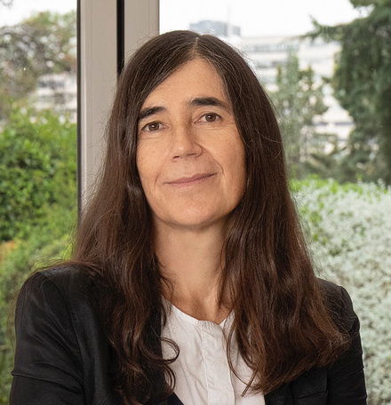
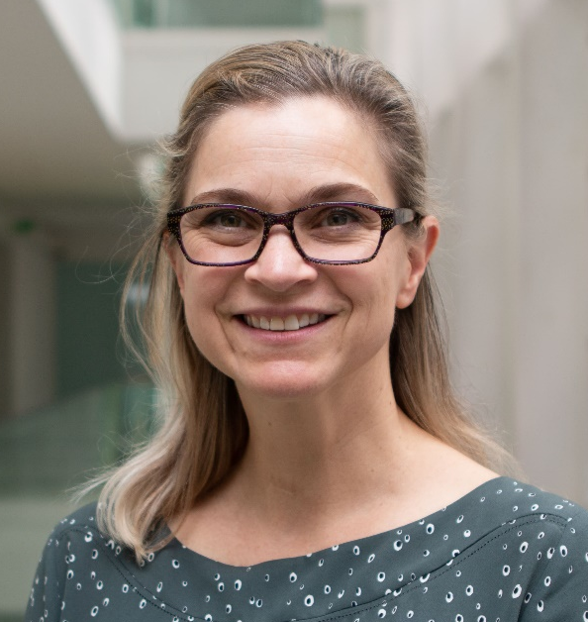
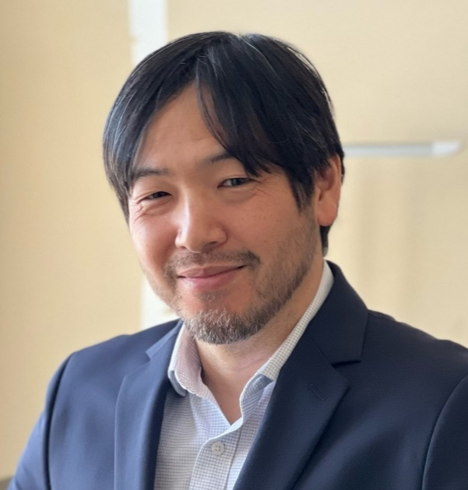
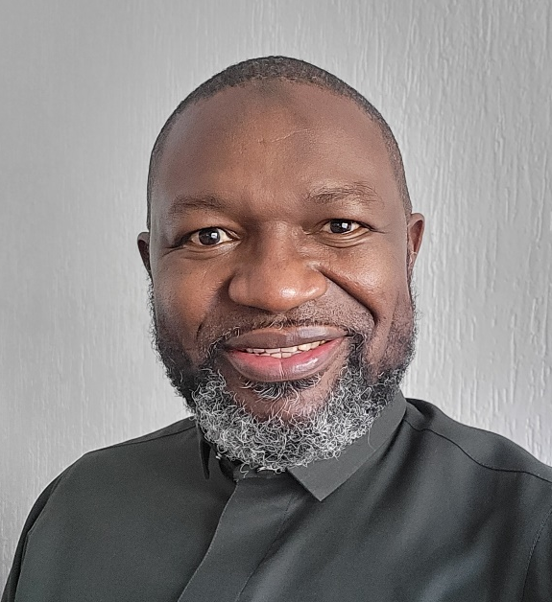
Distinguished Lecture Series
SPEAKERS
Maria A. Blasco
Spanish National Cancer Research Centre, Madrid, Spain
The Role of Telomeres in Aging
and Disease
Leslea J. Hlusko
Spanish National Center for Research on Human Evolution, Burgos, Spain
How Variation in the Shape of Incisors Unlocked a Mystery About Human Evolutionary Adaptation
Nobuhiko Kamada
University of Michigan, Ann Arbor, USA
IFReC, Osaka University, Japan
The Oral-gut Connection in Gastrointestinal Disease
Ahmed Ogwell
United Nations Foundation, Washington, DC, USA
Opportunities for Oral Health in Global Health Security

Slide 18

REGISTRATION IS OPEN!
Important Dates
January 16, 2025: Presenter Pre-registration Deadline
February 3, 2025: Pre-registration Deadline

Slide 19
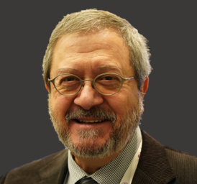
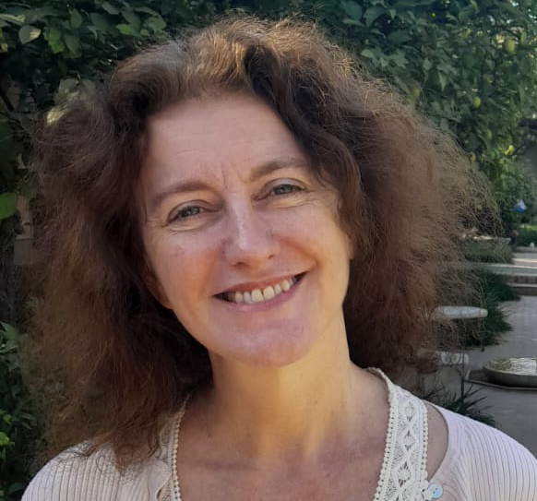
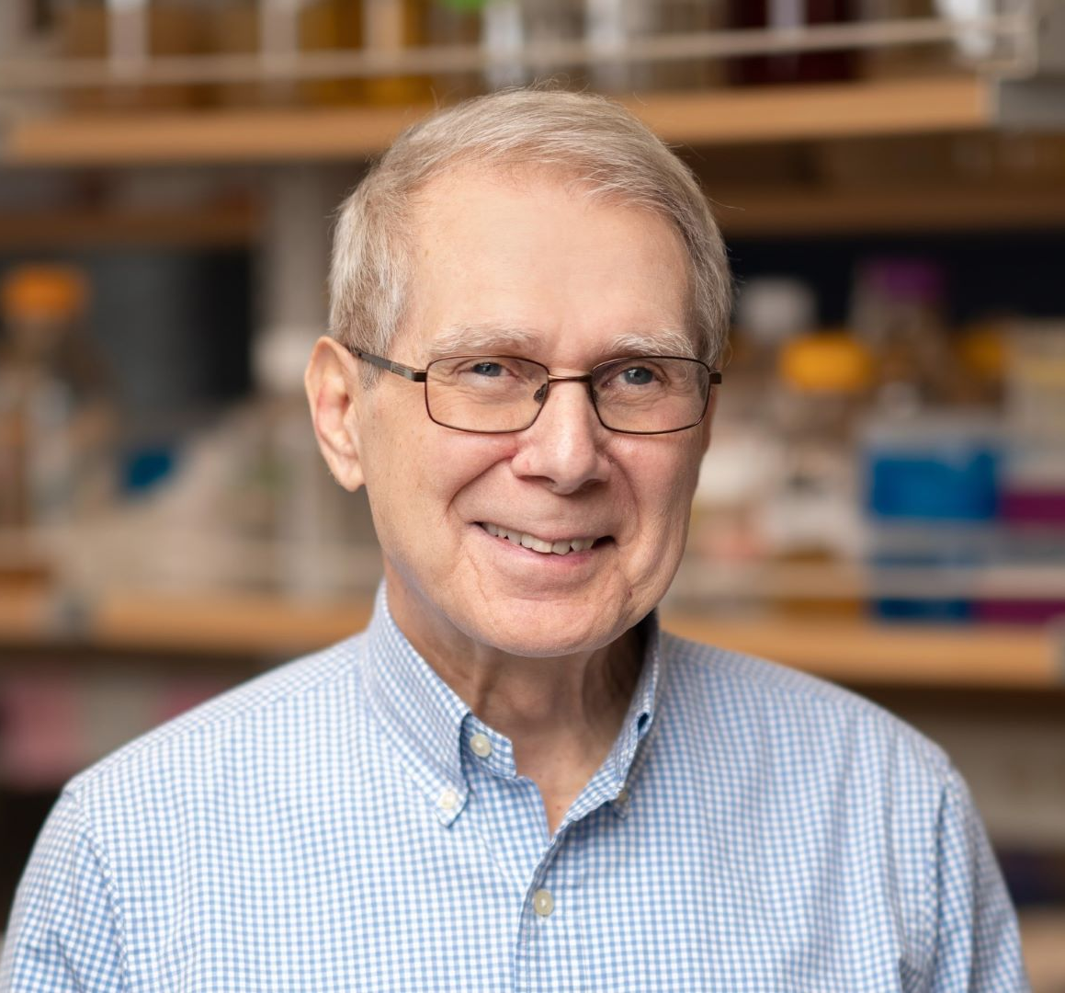
Distinguished Lecture Series
SPEAKERS
Eduardo Franco
McGill University
Montreal, QC, Canada
The Journey to Preventing HPV Infection: Promises and Challenges
Wednesday, March 12, 2025
Abigail Tucker
King’s College London
England, UK
Understanding Dental & Craniofacial Birth Defects Using Diverse Animal Models
Thursday, March 13, 2025
Kim Lewis
Northeastern University
Boston, MA, USA
Persister Cells and Antibiotic Discovery
Friday, March 14, 2025

Slide 20
Contact Us
Email us with any questions about IADR membership, journals, or meetings at research@iadr.org or give us a call at +1.703.548.0066.
Visit us online at www.iadr.org.
Notes:
In closing, more information about the items I have covered is available on the IADR website. If you have questions, please feel free to contact the IADR Global Headquarters by phone or email.

Slide 21


Notes:
Follow IADR on social media!

