Slide 1
The IADR is a nonprofit organization with a mission to drive dental, oral, and craniofacial research for health and well-being worldwide. IADR represents the individual scientists, clinician-scientists, dental professionals, and students based in academic, government, non-profit and private-sector institutions who share our mission.

Slide 2
IADR Values
Scientific Excellence IADR values science conducted at the highest possible levels of rigor, innovation and ethics, across disciplines, from discovery science to clinical implementation to global population health.
Social Responsibility IADR values the pursuit of science to improve health and well-being for all people, to reduce health inequalities and inequities, and proactively takes actions and positions to improve health.
Scientific Community IADR values a diverse and inclusive scientific workforce, promotes work-life balance, and supports educational activities and mentoring networks to develop the next generation of scientists.
Notes:
The IADR Core Values are: Excellence, Responsibility and Community.

Slide 3
Board of Directors
President Satoshi Imazato, Osaka University, Japan
President-elect Pamela Yelick, Tufts University, Boston, MA, USA
Vice-president Jennifer Gallagher, King’s College London, England, UK
Immediate Past President Ophir Klein, Cedars-Sinai, Los Angeles, CA, USA
Treasurer Alvaro Della Bona, University of Passo Fundo, Brazil
Regional Board Member, Africa/Middle East Region
Sadika Khan, University of Western Cape, Cape Town, South Africa
Regional Board Member - Asia/Pacific Region
Yong-Ouk You, Wonkwang University, Iksan, Republic of Korea
Regional Board Member - Pan European Region
Marcello Riggio, University of Glasgow, Scotland
Regional Board Member - Latin American Region
Gabriel Sanchez, Universidad de Buenos Aires, Argentina
Regional Board Member - North American Region
Olga Baker, University of Missouri-Columbia, USA
Young Investigator Representative
Gustavo Nascimento, National Dental Research Institute Singapore
Young Investigator Representative
Fatemeh Momen-Heravi, Columbia University, New York, USA
JDR Editor-in-Chief Nicholas Jakubovics, Newcastle University, England, UK
JDR CTR Editor-in-Chief
Jocelyne Feine, McGill University, Montreal, Canada
Chief Executive Officer Christopher H. Fox, IADR, Alexandria, VA, USA

Slide 4
IADR Regional Structure
IADR
NAR
LAR
APR
PER
AMER
East & Southern African
Iranian
Iraqi
Kuwaiti
Nigerian
Saudi Arabian
South African
Egyptian
Jordanian
Lebanese
Libyan
Palestinian Qatari
Sudanese
Syrian
Tunisian United Arab Emirates
ANZ Chinese
Indian
Japanese
Korean
SEA
Mongolian
Pakistani
Argentine
Brazilian
Chilean
Colombian
Costa Rican
Peruvian
Uruguayan
Venezuelan
Bolivian Caribbean Ecuadorian
Guatemalan
Panamanian
Paraguayan
AADOCR
CADR
Mexican
British
CED
Irish
Israeli
Scandinavian
Russian
29 Divisions: Black 19 Sections: Blue

Slide 5
2024 IADR Membership by Region
PER
NAR
1,723
3,575
APR
2,326
AMER
LAR
664
808
Total Membership: 9,096

Slide 6
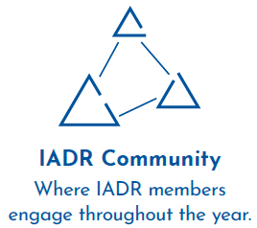
Membership Benefits
Notes:
An IADR membership offers many benefits including access to the online IADR Community, IADR Webinar & CE On Demand Library, publications, discounts on meeting registrations, presentation and awards/fellowship opportunities, access to the abstract archive, the Global Research Update newsletter, membership in IADR Scientific Groups or Networks and much more.

Slide 7
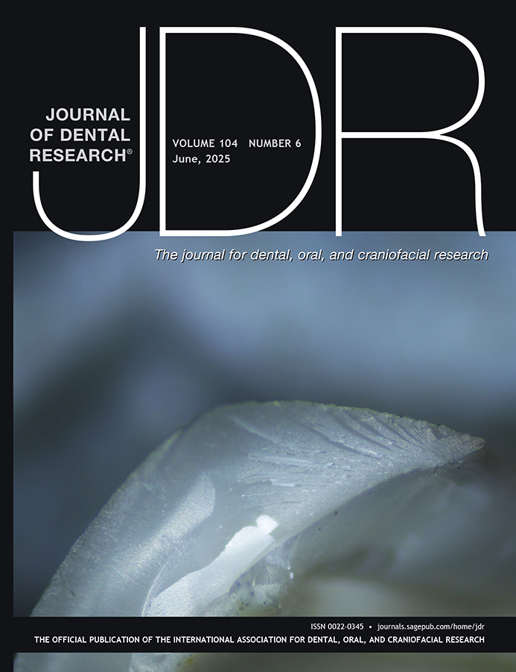
Journal of Dental Research
Editor-in-Chief: Nicholas Jakubovics
Journal Citation Reports™ results for the JDR:
2-year Journal Impact Factor™: 5.7, ranking #4 of 157
5-year Journal Impact Factor™: 7.6, ranking #4 of 157
Eigenfactor: 0.01265, ranking #3 of 157
Immediacy Index: 1.1, ranking #13 of 157
Total citations: 24,424, ranking #1 of 157
Article Influence Score: 1.771, ranking #4 of 157
Acceptance ratio (2022): 15%
Acceptance ratio (2023): 13%
Published manuscripts appear in print and Online First, by which forthcoming articles are published online before they are scheduled to appear in print.
www.iadr.org/jdr
Follow the JDR on Twitter @JDentRes (75 Following, 2,663 Followers)

Slide 8
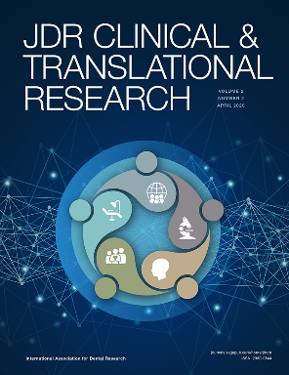
JDR Clinical & Translational Research
Editor-in-Chief: Jocelyne S. Feine
Journal Citation Reports™ results for the JDR CTR:
Journal Impact Factor™: 2.2, ranking #52 of 157 journals
Eigenfactor™: 0.00142
Immediacy Index: 0.300
Acceptance ratio (2022): 41.5%
Acceptance ratio (2023): 25.2%
Average Turnaround Times (2023):
Submission to first decision: 35 days
Submission to acceptance: 138 days
Acceptance to online publications: 40 days
Acceptance to print publication: 383 days
www.iadr.org/jdrctr
Follow the JDR CTR on Twitter @JDRClinTransRes (31 Following, 443 Followers)

Slide 9
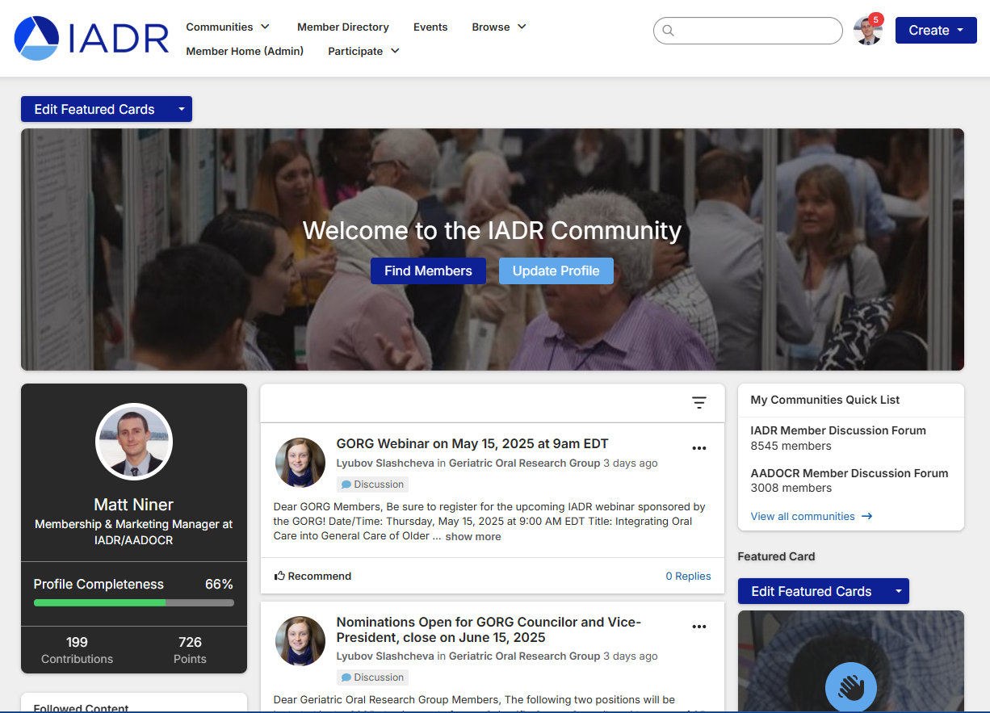
IADR Community
The IADR Online Community allows members to engage with their colleages throughout the year.
Members can discuss hot topics, share insights, and post resources while building their worldwide professional network.

Slide 10
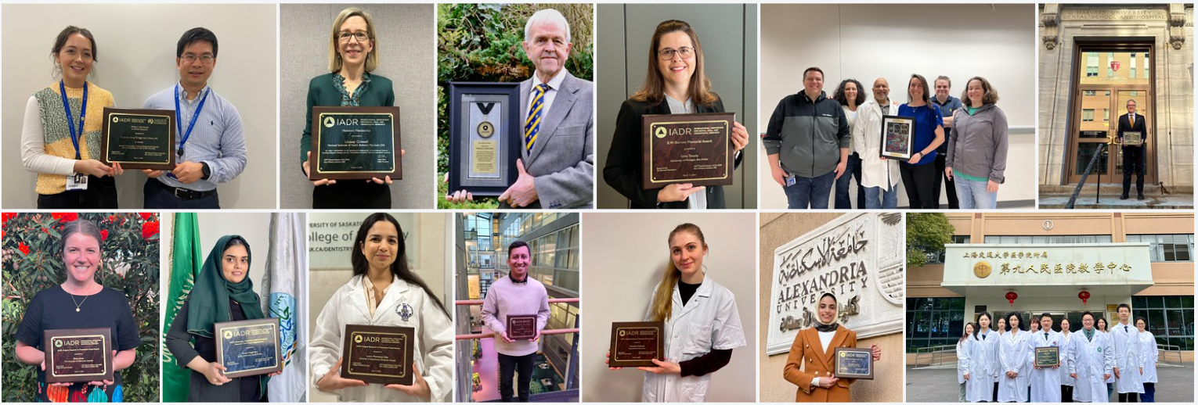
IADR Awards & Fellowships
40+ awards and fellowships in numerous categories
Distinguished Scientist Awards: 17 categories
Student & Scientific Group Awards
IADR Hatton Competition: Junior, Senior Clinical, & Senior Basic Science
Notes:
IADR has opportunities for members to be recognized for their research contributions through Awards and Fellowships. There are more than 40 awards and fellowships in various categories, including student awards. Visit the IADR website for the deadlines for the 2023 Awards and Fellowships.

Slide 11
IADR Webinar & CE On Demand Library
Gain the latest insights in dental, oral, and craniofacial research using the IADR Webinar & CE On Demand Library! Attend live webinars, interact with speakers, and view recordings of past webinars and cutting-edge presentations from IADR and AADOCR meetings.
Notes:
Attend live webinars where you can interact with speakers or view recordings of past webinars and cutting-edge presentations from IADR and AADOCR meetings. Members can submit a webinar proposal for consideration!

Slide 12
A New Members-Only Series by the IADR Scientific Groups & Networks

Slide 13
IADR Scientific Groups & Networks
Scientific Groups (25)
Behavioral, Epi & HSR
Cariology Research
Craniofacial Biology
Dental Anesthesiology and
Special Care Research
Dental Materials
Diagnostic Sciences
Education Research
Geriatric Oral Research
Implantology Research
Lasers & Biophotonics
Microbiology/Immunology
Mineralized Tissue
Networks (11)
Clinical and Translational Science
Digital Dentistry Research Network
e-Oral Health Network
Evidence-based Dentistry
Global Oral Health Inequalities Research
International Network for Orofacial Pain and Related Disorders Methodology (INfORM)
Minimally Invasive Dentistry Network
Network for Practice-based Research
Oral Malodor Network – NEW!
Student Training and Research (STAR)
Women in Science Network
Neuroscience
Nutrition Research
Oral & Maxillofacial Surgery
Oral Health Research
Oral Medicine & Pathology
Orthodontics Research
Pediatric Oral Health Research
Periodontal Research
Pharmacology/Therapeutics/
Toxicology
Prosthodontics
Pulp Biology & Regeneration
Salivary Research
Stem Cell Biology

Slide 14
IADR Support for Low and Middle-Income Countries (LMICs)
IADR Regional Development Program
IADR promotes oral health research worldwide with a specific emphasis on assistance and education. Since 1996, the Regional Development Program has distributed more than $1.3 million in funding to enhance capacity and infrastructure in regions with less developed research programs.
Awards and Fellowships
The IADR Centennial Travel Award for New Investigators, the IADR Newell W. Johnson Travel Award, and the IADR Smile Train Cleft Research Award offer funding specifically to members of LMICs to promote research development and attendance at the IADR General Sessions.
IADR Adopt-a-Member Fund
Donations to the fund directly support IADR Members and Student Members in LMICs in paying IADR annual membership dues and/or IADR General Session registration fees.
Tiered Dues and Registration Fees
IADR offers significantly discounted rates for individuals from LMICs on membership as well as for registration at the annual IADR General Session & Exhibition.

Slide 15
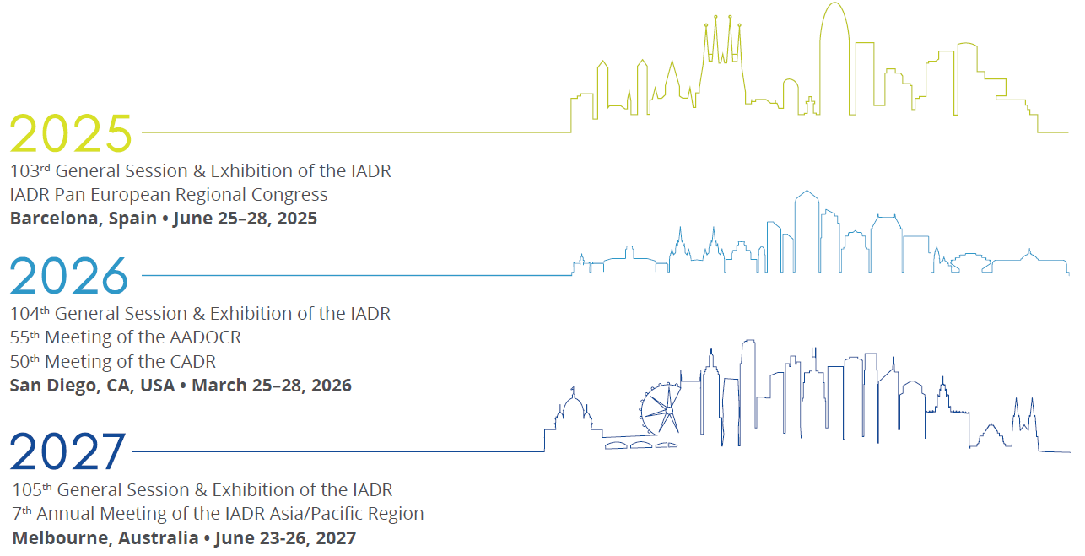
Future Meetings

Slide 16
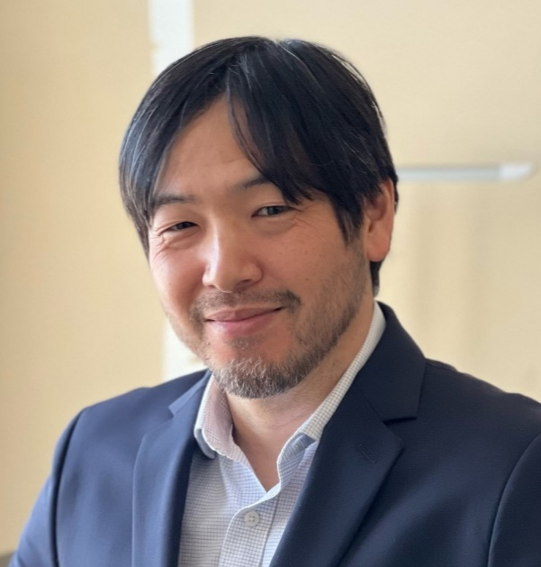
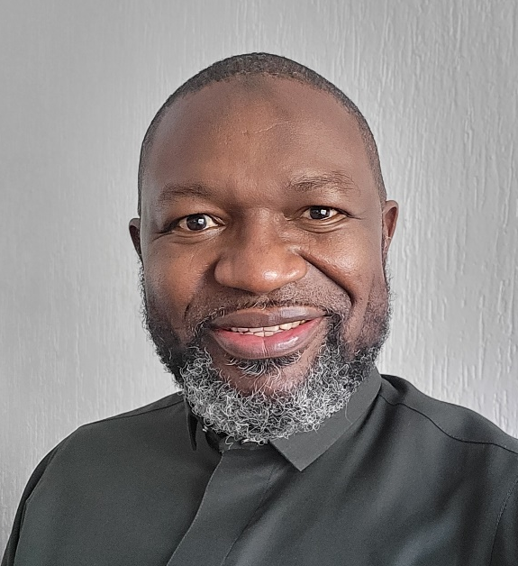
Distinguished Lecture Series SPEAKERS
Leslea J. Hlusko Spanish National Center for Research on Human Evolution, Burgos, Spain How Variation in the Shape of Incisors Unlocked a Mystery About Human Evolutionary Adaptation
Nobuhiko Kamada University of Michigan, Ann Arbor, USA
IFReC, Osaka University, Japan The Oral-gut Connection in Gastrointestinal Disease
Ahmed Ogwell VillageReach, Seattle, USA Opportunities for Oral Health in Global Health Security

Slide 18
Contact Us
Email us with any questions about IADR membership, journals, or meetings at research@iadr.org or give us a call at +1.703.548.0066. Visit us online at www.iadr.org.
Notes:
In closing, more information about the items I have covered is available on the IADR website. If you have questions, please feel free to contact the IADR Global Headquarters by phone or email.

Slide 19
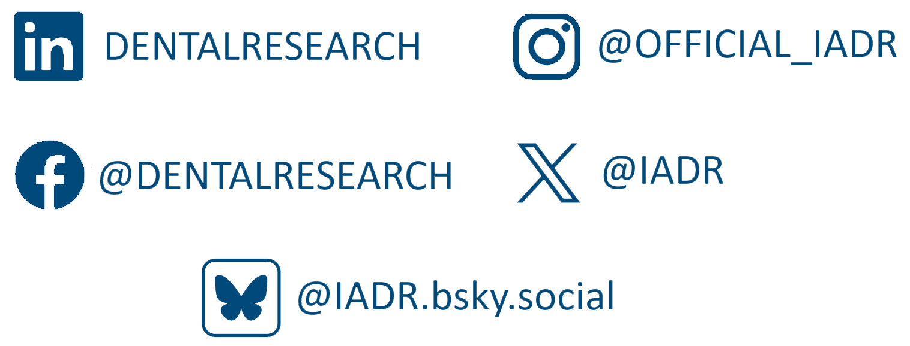
Follow IADR on Social Media
Notes:
In closing, more information about the items I have covered is available on the IADR website. If you have questions, please feel free to contact the IADR Global Headquarters by phone or email.

