Slide 1


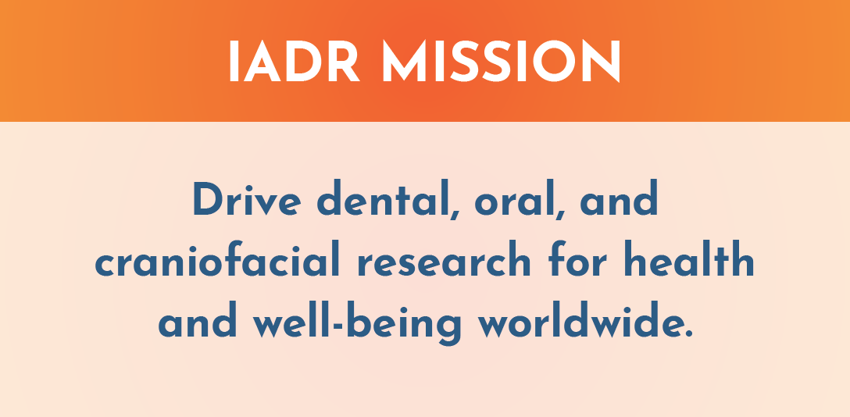
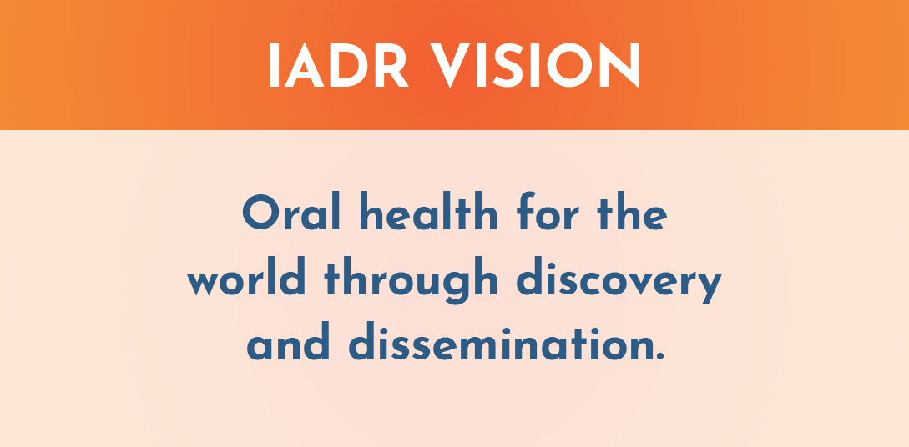
The IADR is a nonprofit organization with a mission to drive dental, oral, and craniofacial research for health and well-being worldwide. IADR represents the individual scientists, clinician-scientists, dental professionals, and students based in academic, government, non-profit and private-sector institutions who share our mission.

Slide 2
IADR Values
Scientific Excellence
IADR values science conducted at the highest possible levels of rigor, innovation and ethics, across disciplines, from discovery science to clinical implementation to global population health.
Social Responsibility
IADR values the pursuit of science to improve health and well-being for all people, to reduce health inequalities and inequities, and proactively takes actions and positions to improve health.
Scientific Community
IADR values a diverse and inclusive scientific workforce, promotes work-life balance, and supports educational activities and mentoring networks to develop the next generation of scientists.
Notes:
The IADR Core Values are: Excellence, Responsibility and Community.

Slide 3
Board of Directors
  President
  Pamela Yelick
  Tufts University
  President-elect
  Jennifer Gallagher
  King’s College London
  Vice-president
  Raul Garcia
  Boston University
  Immediate Past President
  Satoshi Imazato
  Osaka University
  Treasurer
  Alvaro Della Bona
  University of Passo Fundo
  Regional Board Member, Africa/Middle East Region
  Saadika Khan
  University of Western Cape
  Regional Board Member - Asia/Pacific Region
  In-Sung Yeo
  Seoul National University
  Regional Board Member - Pan European Region
  Marcello Riggio
  University of Glasgow
  Regional Board Member - Latin American Region
  Gabriel Sanchez
  Universidad de Buenos Aires
  Regional Board Member - North American Region
  Olga Baker
  University of Missouri-Columbia
  Young Investigator Representative
  Gustavo Nascimento
  National Dental Research Institute, Singapore
  Young Investigator Representative
  Santosh Takamandla
  La Trobe Rural Dental & Oral Health Clinical School
  JDR Editor-in-Chief
  Nicholas Jakubovics
  Newcastle University
  JDR CTR Editor-in-Chief
  Jocelyne Feine
  McGill University
  Chief Executive Officer
  Christopher H. Fox
  IADR/AADOCR

Slide 4


IADR Regional Structure
IADR
NAR
LAR
APR
PER
AMER
East & Southern African
Iranian
Iraqi
Kuwaiti
Nigerian
Saudi Arabian
South African
Egyptian
Jordanian
Lebanese
Libyan
Palestinian
Qatari
Sudanese
Syrian
Tunisian
United Arab Emirates
ANZ
Chinese
Indian
Japanese
Korean
SEA
Mongolian
Pakistani
Argentine
Brazilian
Chilean
Colombian
Costa Rican
Peruvian
Uruguayan
Venezuelan
Bolivian
Caribbean
Ecuadorian
Guatemalan
Panamanian
Paraguayan
AADOCR
CADR
Mexican
British
CED
Irish
Israeli
Scandinavian
Russian
29 Divisions: Black
19 Sections: Blue

Slide 5
IADR Membership by Region
PER
NAR
2,161
3,555
APR
2,938
AMER
LAR
664
825
Total Membership: 10,143
as of August 1, 2025

Slide 6

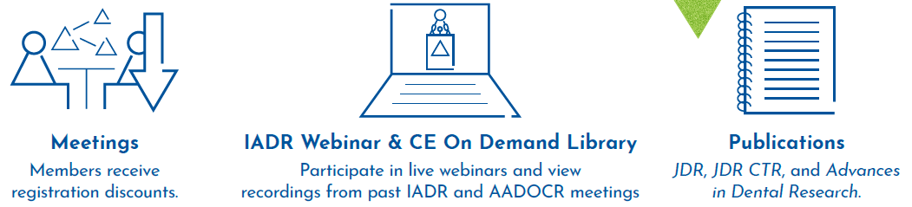
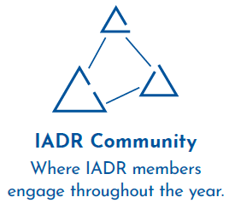


Membership Benefits
Notes:
An IADR membership offers many benefits including access to the online IADR Community, IADR Webinar & CE On Demand Library, publications, discounts on meeting registrations, presentation and awards/fellowship opportunities, access to the abstract archive, the Global Research Update newsletter, membership in IADR Scientific Groups or Networks and much more.

Slide 7
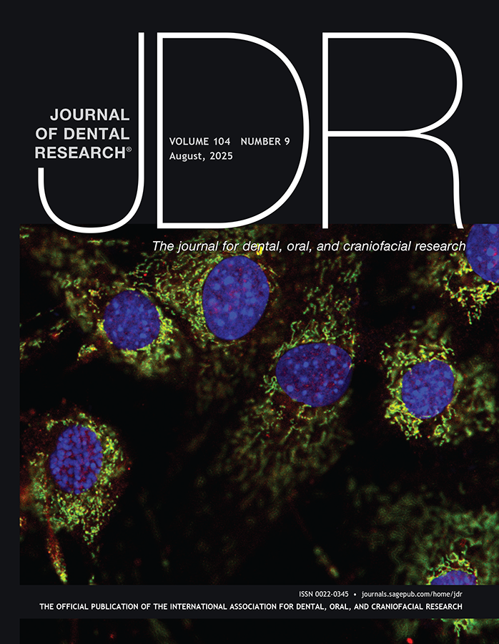
Journal of Dental Research
Editor-in-Chief: Nicholas Jakubovics
Journal Citation Reports™ results for the JDR:
  Total citations: 24,424, ranking #1 of 162
  Journal Impact Factor™: 5.9, ranking #7 of 162
  5-year Journal Impact Factor™: 7.3, ranking #5 of 162
  Article Influence Score: 1.657, ranking #4 of 162
  Eigenfactor: 0.01126
  Immediacy Index: 0.9
Published manuscripts appear in print and Online First, by which forthcoming articles are published online before they are scheduled to appear in print.
www.iadr.org/jdr
Follow the JDR on Twitter @JDentRes (75 Following, 2,663 Followers)

Slide 8
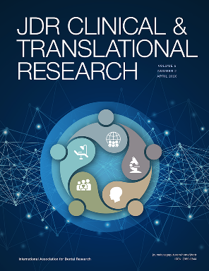
JDR Clinical & Translational Research
Editor-in-Chief: Jocelyne S. Feine
Journal Citation Reports™ results for the JDR CTR:
  Journal Impact Factor™: 2.2, ranking #59 of 162 journals
  5-year Journal Impact Factor™: 2.8
  Article Influence Score: 0.674
  Eigenfactor™: 0.00127
  Immediacy Index: 0.300
Follow the JDR CTR on Twitter @JDRClinTransRes (31 Following, 443 Followers)
www.iadr.org/jdrctr

Slide 9
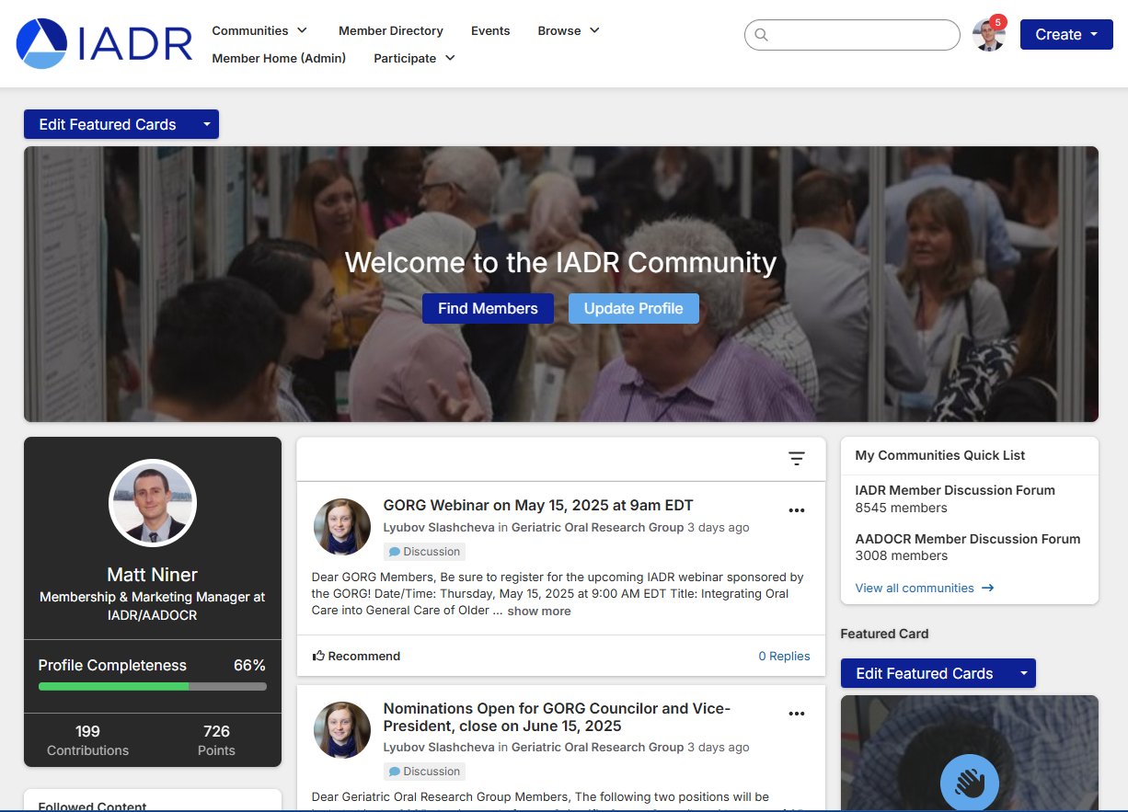
IADR Community
The IADR Online Community allows members to engage with their colleagues throughout the year.
Members can discuss hot topics, share insights, and post resources while building their worldwide professional network.

Slide 10
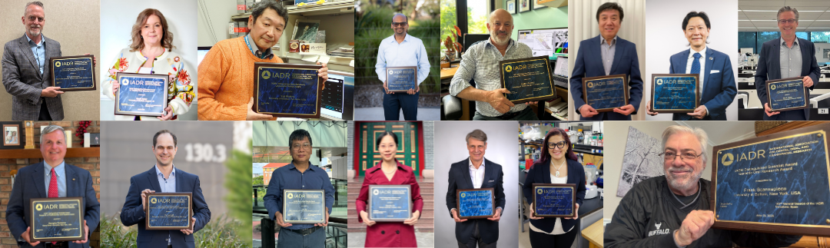
IADR Awards & Fellowships
40+ awards and fellowships in numerous categories
Distinguished Scientist Awards: 17 categories
Student & Scientific Group Awards
IADR Hatton Competition: Junior, Senior Clinical, & Senior Basic Science
Notes:
IADR has opportunities for members to be recognized for their research contributions through Awards and Fellowships. There are more than 40 awards and fellowships in various categories, including student awards. Visit the IADR website for the deadlines for the 2023 Awards and Fellowships.

Slide 11
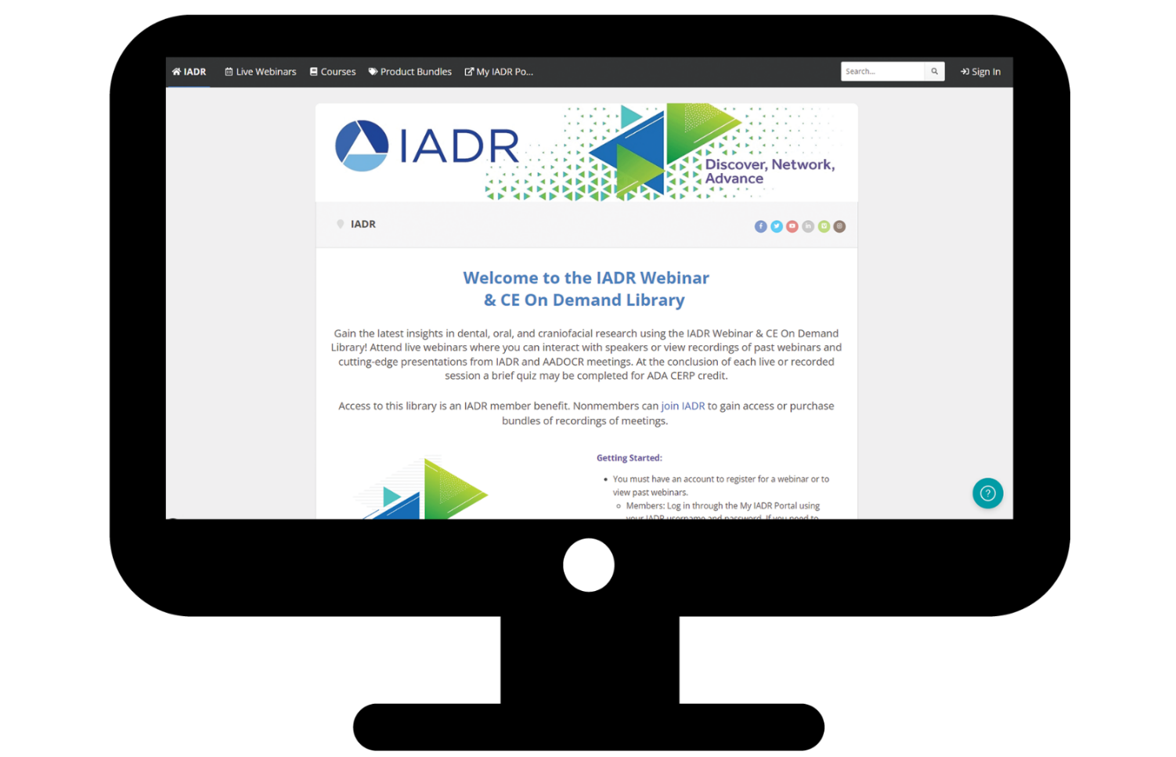
IADR Webinar & CE On Demand Library
Gain the latest insights in dental, oral, and craniofacial research using the IADR Webinar & CE On Demand Library! Attend live webinars, interact with speakers, and view recordings of past webinars and cutting-edge presentations from IADR and AADOCR meetings.
Notes:
Attend live webinars where you can interact with speakers or view recordings of past webinars and cutting-edge presentations from IADR and AADOCR meetings. Members can submit a webinar proposal for consideration!

Slide 12

A Members-Only Series by the IADR Scientific Groups & Networks

Slide 13
IADR Scientific Groups & Networks
Scientific Groups
Behavioral, Epi & HSR
Cariology Research
Craniofacial Biology
Dental Anesthesiology and
Special Care Research
Dental Materials
Diagnostic Sciences
Education Research
Geriatric Oral Research
Implantology Research
Lasers & Biophotonics
Microbiology/Immunology
Mineralized Tissue
Networks
Clinical and Translational Science
Digital Dentistry Research Network
e-Oral Health Network
Evidence-based Dentistry
Global Oral Health Inequalities Research
International Network for Orofacial Pain and Related Disorders Methodology (INfORM)
Minimally Invasive Dentistry Network
Network for Practice-based Research
Oral Malodor Network
Pride in Dental Research Network – NEW!
Student Training and Research (STAR)
Women in Science Network
Neuroscience
Nutrition Research
Oral & Maxillofacial Surgery
Oral Health Research
Oral Medicine & Pathology
Orthodontics Research
Pediatric Oral Health Research
Periodontal Research
Pharmacology/Therapeutics/
Toxicology
Prosthodontics
Pulp Biology & Regeneration
Salivary Research
Stem Cell Biology

Slide 14
IADR Support for Low and Middle-Income Countries (LMICs)
IADR Regional Development Program
IADR promotes oral health research worldwide with a specific emphasis on assistance and education. Since 1996, the Regional Development Program has distributed more than $1.3 million in funding to enhance capacity and infrastructure in regions with less developed research programs.
Awards and Fellowships
The IADR Centennial Travel Award for New Investigators, the IADR Newell W. Johnson Travel Award, and the IADR Smile Train Cleft Research Award offer funding specifically to members of LMICs to promote research development and attendance at the IADR General Sessions.
IADR Adopt-a-Member Fund
Donations to the fund directly support IADR Members and Student Members in LMICs in paying IADR annual membership dues and/or IADR General Session registration fees.
Tiered Dues and Registration Fees
IADR offers significantly discounted rates for individuals from LMICs on membership as well as for registration at the annual IADR General Session & Exhibition.

Slide 15
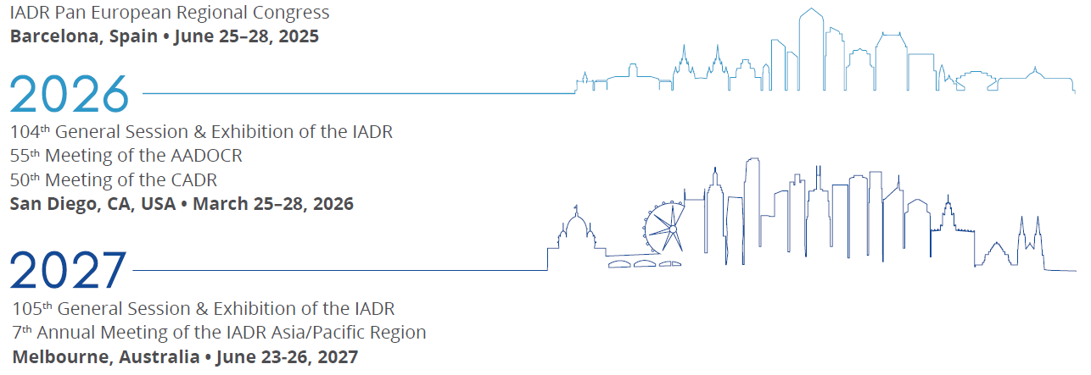
Future Meetings

Slide 16


Now accepting Abstracts and Sesson Proposals!
September 29
Session Proposal Submission Deadline
October 22
Abstract Submission Deadline

Slide 17
Contact Us
Email us with any questions about IADR membership, journals, or meetings at research@iadr.org or give us a call at +1.703.548.0066.
Visit us online at www.iadr.org.
Notes:
In closing, more information about the items I have covered is available on the IADR website. If you have questions, please feel free to contact the IADR Global Headquarters by phone or email.

Slide 18
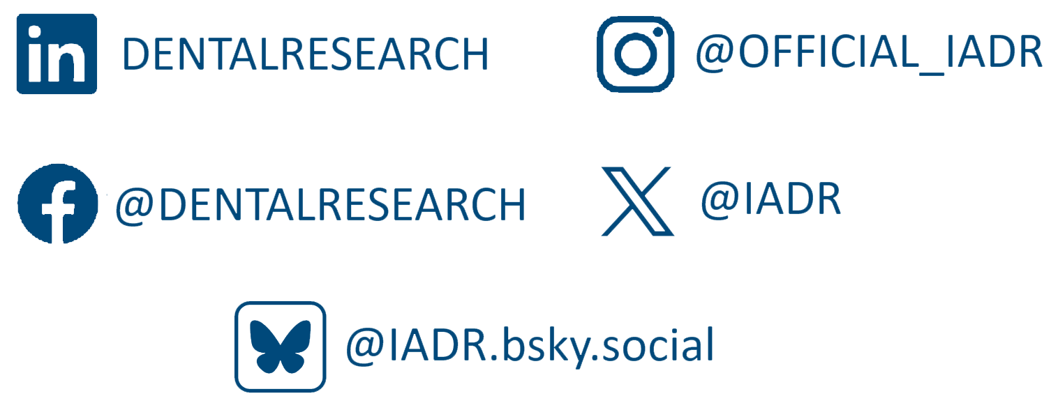
Follow IADR on Social Media
Notes:
In closing, more information about the items I have covered is available on the IADR website. If you have questions, please feel free to contact the IADR Global Headquarters by phone or email.

